Slide 1
Ifxapp A reusable Python-based Qt widget library for radar applications
Kleinmeier Benedikt
Nov 19, 2024
Notes:
A warm welcome from my side.
I am Benedikt, a SW developer here in the APP team of PSS RFS.
As APP team we support HW bring-up activities by providing initial FWs or just to visualize data. We are also servicing customer requests (for example: A customer says we require a Python script to fetch data from a Smartar sensor).

Slide 2
Table of contents
1
Motivation
3
2
Ifxapp: Overview
7
3
Ifxapp: Demos
16
Notes:
To set the stage: This will be a tool overview and not a deep dive into the code. We could have a separate session on that. And, please interrupt me if you have any questions.
I divided the presentation into three topics.
What’s the motivation behind ifxapp.
What is it.
And finally some live demos so you get a good impression what you can do with it.

Slide 3
Motivation

Slide 4
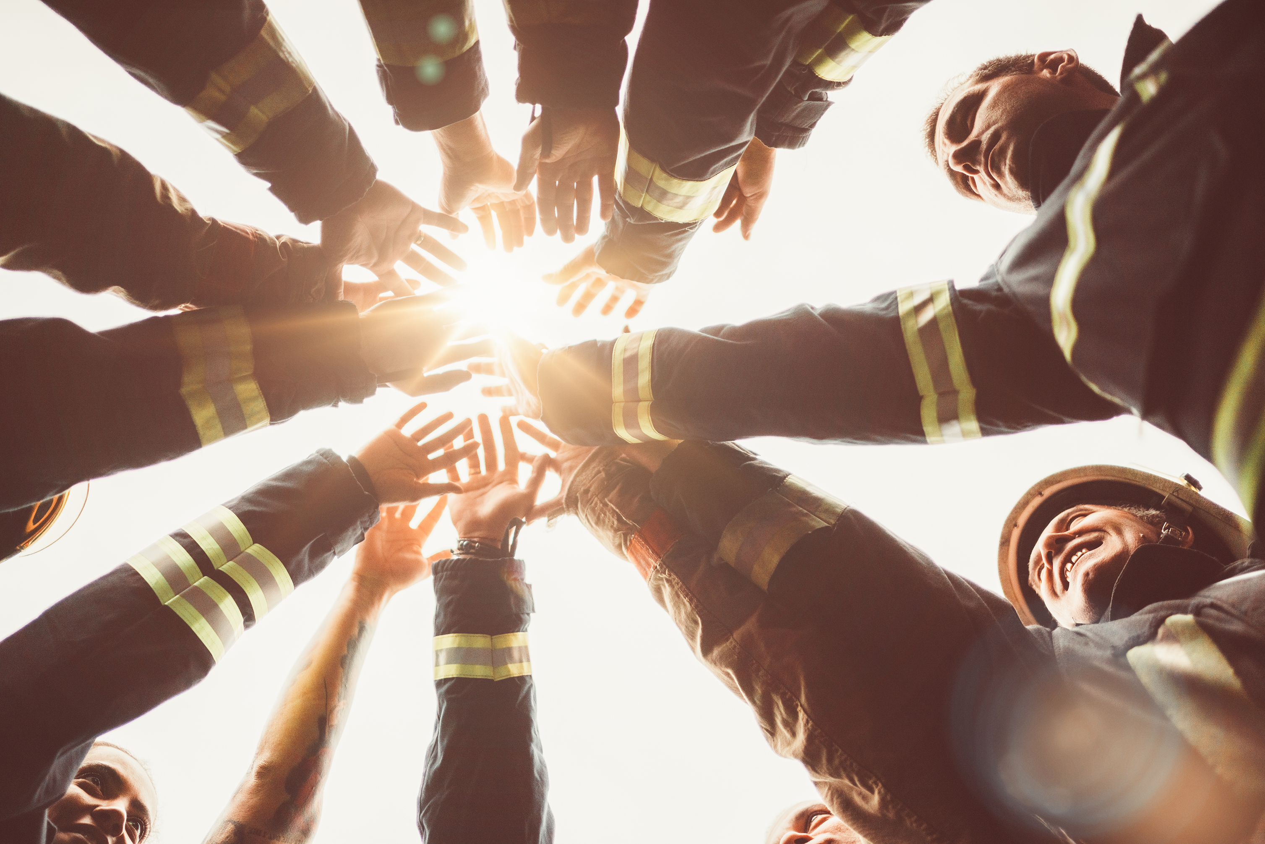
Motivation: Ifxapp
Current status: PSS RFS develops different applications (SmartTV, Air Condition, Security Camera & Doorbell), in different teams spread around the globe!
How to lift synergies between these development efforts?

Slide 5
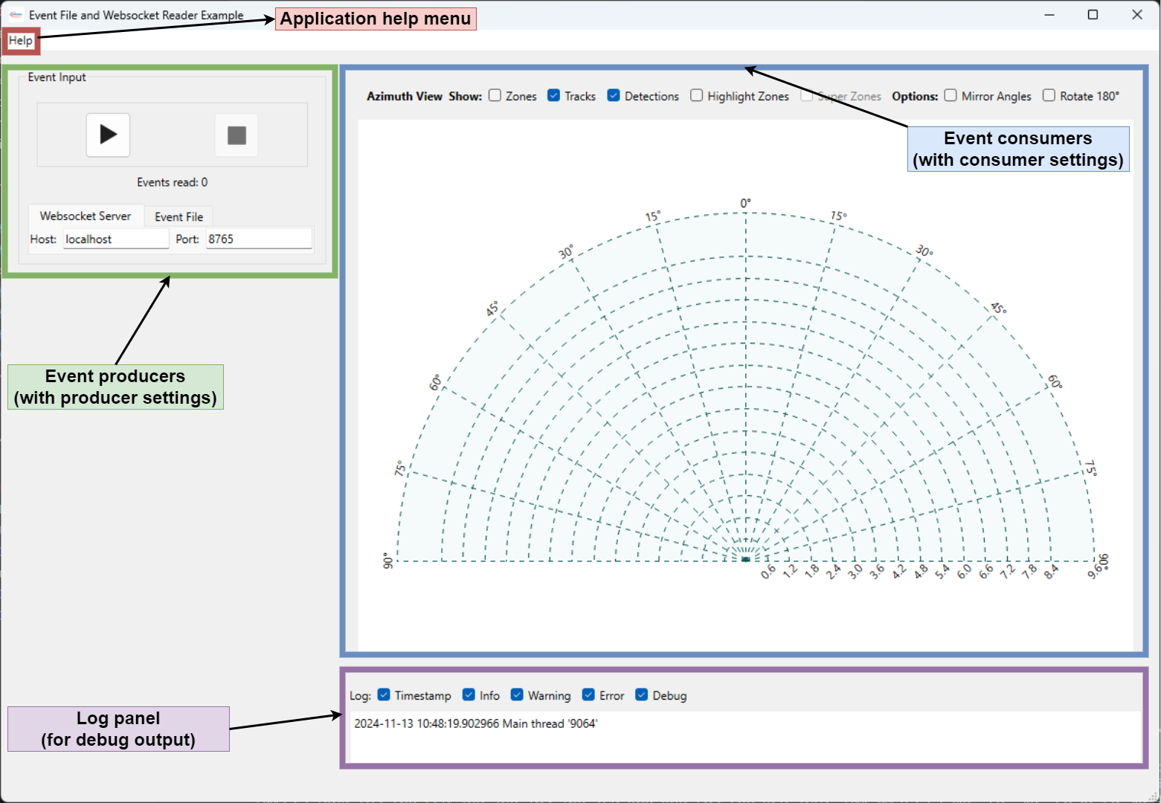
Motivation: Ifxapp
By providing a reusable GUI library for radar data visualization!
Benefits:
Common look & feel
Can be used across different projects
Builds up abstractions I.e., embedded devs can focus on data communication, algo devs on algo development etc.
Notes:
Common look & feel
Can be used across different projects
Builds up abstractions (embedded devs can focus on data communication, algo devs on algo development)

Slide 6
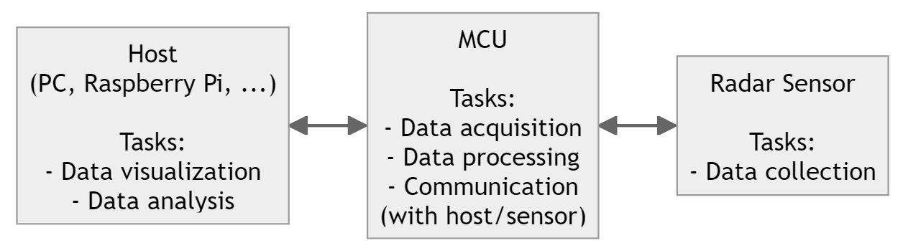
Assumptions
An application usually runs on a microcontroller (MCU) and consists of:
An algorithm* which processes data from a radar sensor (Smartar) and
Code to communicate to a PC and to the actual radar sensor.
* The algorithm is usually implemented in Matlab and converted to C by using Matlab's code generation feature.
An application is usually also complemented by a small Python-based GUI to visualize the radar data on host side.
Hardware components of an application
Notes:
Final sentence: This is the context in which ifxapp was and is developed.

Slide 7
Ifxapp: Overview

Slide 8
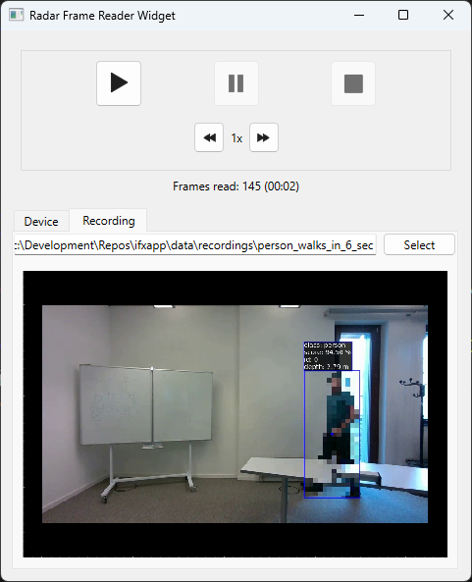
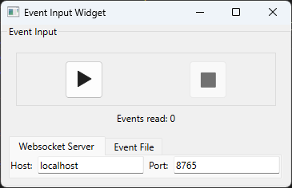
Project goals
Ifxapp:
Offers Qt GUI widgets with a common look-and-feel to visualize algorithm events defined in ifxalgoapi. I.e., ifxapp consumes ifxalgoapi events instead of ADC raw data!
Notes:
These are small and uttermost testable GUI widgets!

Slide 9
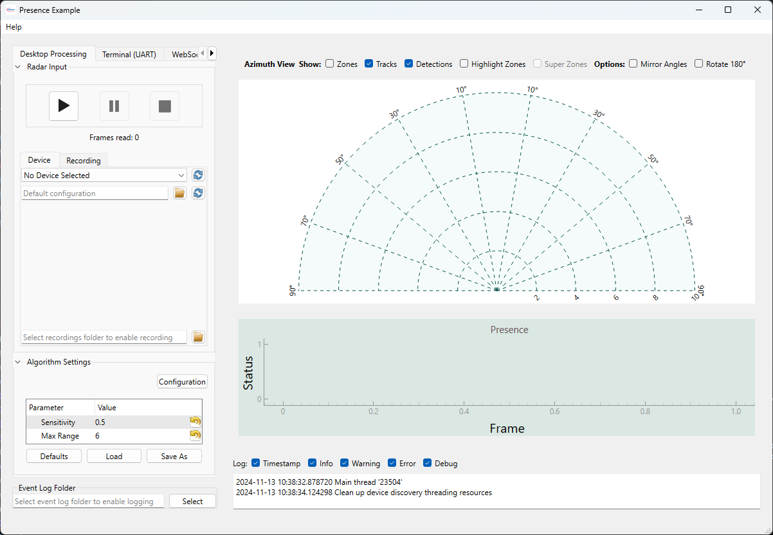
Project goals
Ifxapp:
Offers Qt GUI widgets with a common look-and-feel to visualize algorithm events defined in ifxalgoapi. I.e., ifxapp consumes ifxalgoapi events instead of ADC raw data!
Allows to quickly build GUI main windows for customer demos but also during algorithm development.
Notes:
Out of these GUI widgets you can easily create a main window.

Slide 10
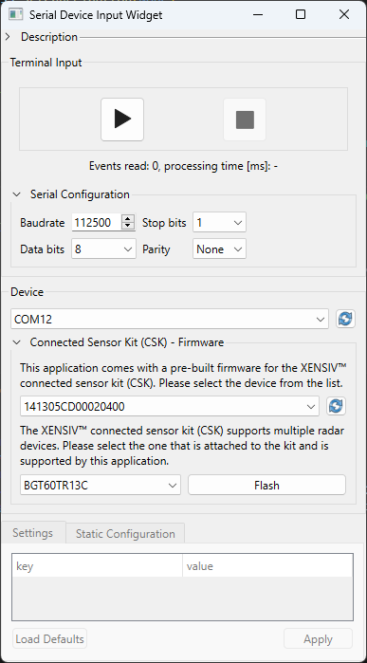
Project goals
Ifxapp:
Offers Qt GUI widgets with a common look-and-feel to visualize algorithm events defined in ifxalgoapi. I.e., ifxapp consumes ifxalgoapi events instead of ADC raw data!
Allows to quickly build GUI main windows for customer demos but also during algorithm development.
Offers access to radar sensors (via Strata firmwares and evaluation kits like CSK).
Notes:
During development, the ifxapp scope was extended to also access radar sensors (via Strata and the CSK).

Slide 11
Ifxapp: Feature overview and event sources
Ifxapp can read radar data (algorithm events) from the following sources:
Files
Radar sensors
Sensor on-chip processing chains (e.g. motion detector)
Access radar processing chains on embedded systems (i.e., directly fetch algorithm output from a MCU FW like CSK)
Websockets (e.g., process radar raw frames in Matlab and send it to ifxapp via websockets)
Ifxapp visualizes:
ifxalgoapi events (AlgoPresenceEvent, AlgoTrackingEvent, …)
Video recordings from ifxdaq
Planned: Custom plots to enable developers to debug their algorithm

Slide 12
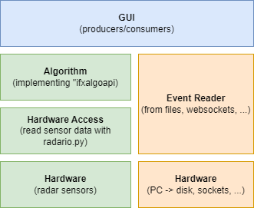
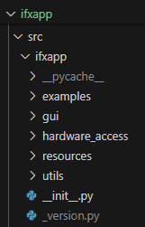
Software architecture
Main windows
Widgets
Non-GUI code to access hardware
Notes:
On the forefront we have the GUI which offers so called event producer widgets and consumer widgets (you could also think of data sources and sinks).
In the right pillar events are directly read from files or websocket.
In the left pillar, first raw radar frames are fetched from a radar sensor and then an algo is fed with this data.
This structure is also reflected in the repo structure.

Slide 13
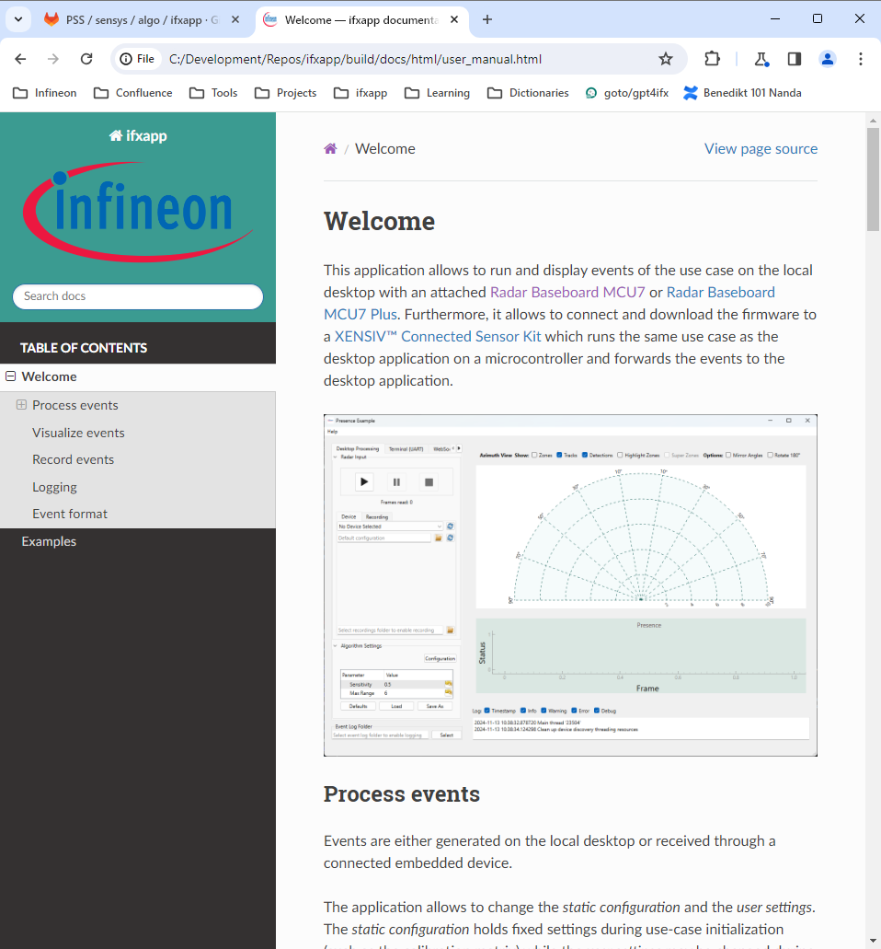
Project setup
Repo on GitLab
Ticket-driven approach with feature branches and merge requests
Release notifications on Webex
A Git tag triggers (1) Python .whl creation (2) HTML doc and (3) executable generation (with cx_Freeze)
https://gitlab.acme.com/pss/ifxapp/-/releases
HTML documentation (currently not uploaded to Artifactory)
Dev tools:
Python 3.9
pre-commit 3.7.1
cx_Freeze 7.2.2
pytest 8.2.1
ruff 0.7.1
Sphinx 5.2.1
VS Code 1.87
Code coverage: ~30%
Notes:
Show HTML documentation

Slide 14
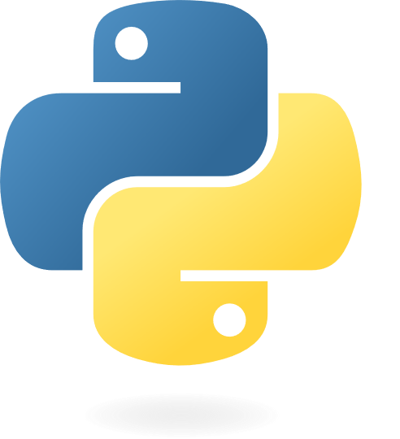
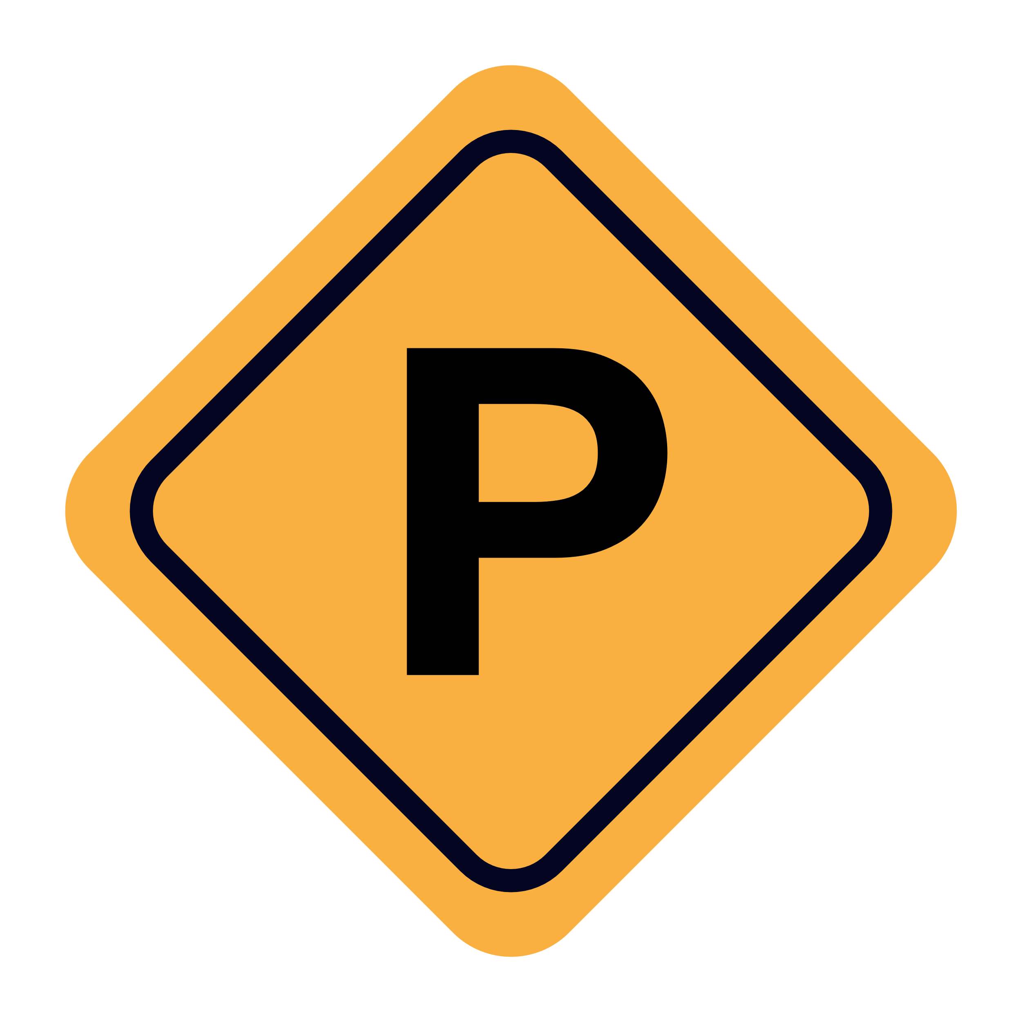
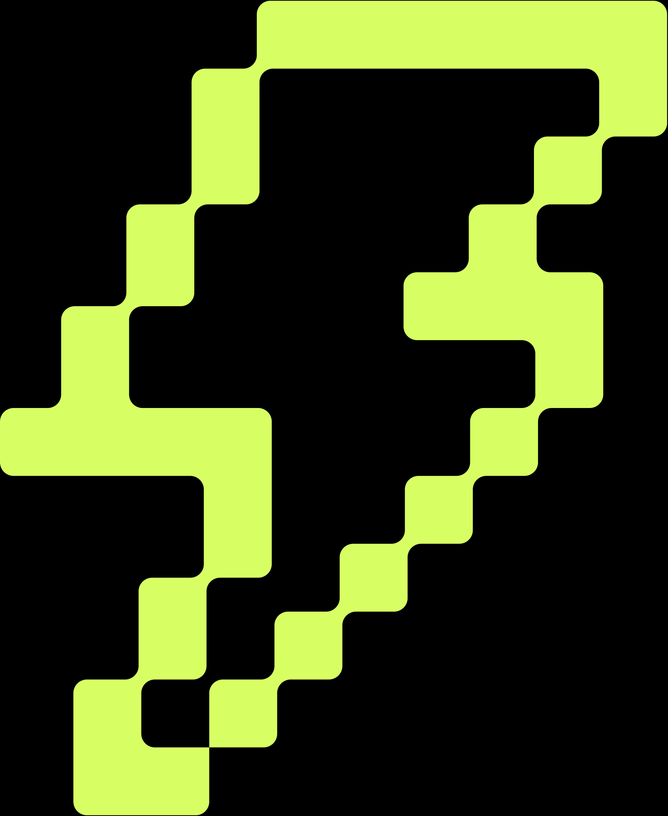
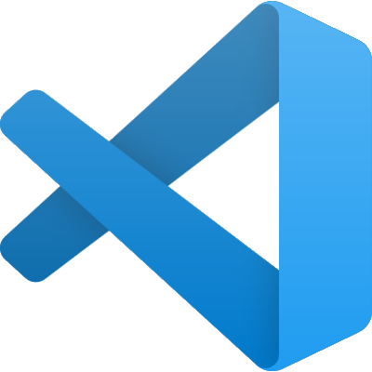
Project setup
Repo on GitLab
Ticket-driven approach with feature branches and merge requests
Release notifications on Webex
A Git tag triggers (1) Python .whl creation (2) HTML doc and (3) executable generation (with cx_Freeze)
https://gitlab.acme.com/pss/ifxapp/-/releases
HTML documentation (currently not uploaded to Artifactory)
Dev tools:
Python 3.9
pre-commit 3.7.1
cx_Freeze 7.2.2
pytest 8.2.1
ruff 0.7.1
Sphinx 5.2.1
VS Code 1.87
Code coverage: ~30%
Notes:
Show HTML documentation

Slide 15
Outlook
Current focus:
Get stable release out the door with minimal feature set to unblock projects.
Next:
Code refactoring (use design patterns, mitigate technical depts etc.)
Increase code coverage (even for a GUI project it is too low)
Implement new features

Slide 16
Ifxapp: Demos

Slide 17
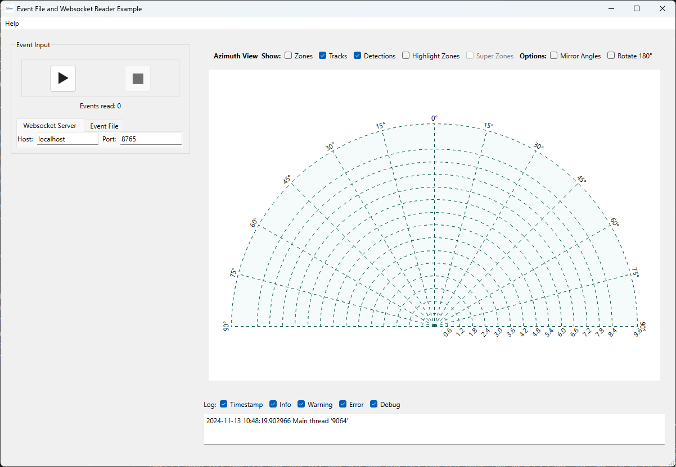
Demos
Demos can be found under src/ifxapp/examples/ folder:
event_file_and_websocket_reader_example.py
presence_example.py
smartar_motion_detector_example.py
Notes:
Show you also that only a few lines of code are necessary to obtain such a main window.

Slide 18
Demos
Demos can be found under src/ifxapp/examples/ folder:
event_file_and_websocket_reader_example.py
presence_example.py
smartar_motion_detector_example.py
Notes:
The presence example is more a full-fledged app where also a dummy implementation of an algo is hooked in.
I.e., raw radar frames are fetched from radar sensors or devices, an algo processes these frames and the outputted events are visualized.

Slide 19
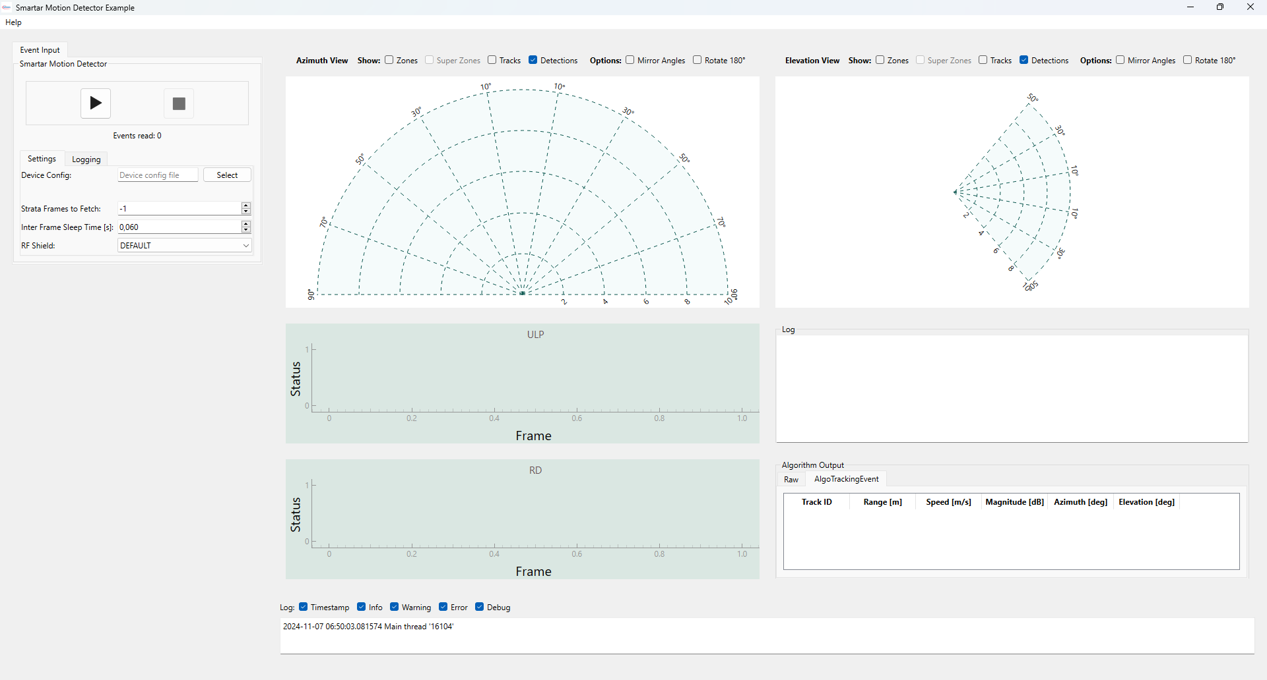
Demos
Demos can be found under src/ifxapp/examples/ folder:
event_file_and_websocket_reader_example.py
presence_example.py
smartar_motion_detector_example.py

Slide 20
How to get started
Try out ifxapp applications and GUI widgets:
Clone and initialize the repo and install ifxapp Python dependencies from `requirements.txt` git clone git@gitlab.acme.com:pss/ifxapp.git cd ifxapp ./scripts/configure_repo.sh code vscode.code-workspace & Note: On Windows, use "Git Bash for Windows" to execute these commands.
Start a demo application: source .venv-3.9/Scripts/activate python src/ifxapp/examples/event_file_and_websocket_reader_example.py
Start individual ifxapp widgets, for instance: source .venv-3.9/Scripts/activate python src/ifxapp/gui/event_consumers/segment_plot.py

